Slide 1

Ministry Category : Department of Defense Production Problem Statement : Provision of Group Members Location and Chatting Problem Code : #DDP8 Team Leader Name : Shriram.B
AICTE Application No : 1-3325551643

Slide 2
Solution
Automated Location Tracking of people in a trusted circle by utilizing Google Maps and Geo-Fencing helps in frequently reaching out to them. The app provides intricate details including current location, battery status, signal strength, route tracking and the ability to check-in at certain locations so as to keep them updated.
During unavailability of Location Services or Network failure, it is possible to track the last base station that the phone is connected to and is shared with the trusted circle, using the PhoneStateListener which can be used for investigation purposes.
It also includes a chat box feature through which users can interact with entire circle or other individual users. The SOS feature updates the trusted circle regarding the current location during an emergency. The trusted circle may involve family members, police officers, special forces etc.,

Slide 3
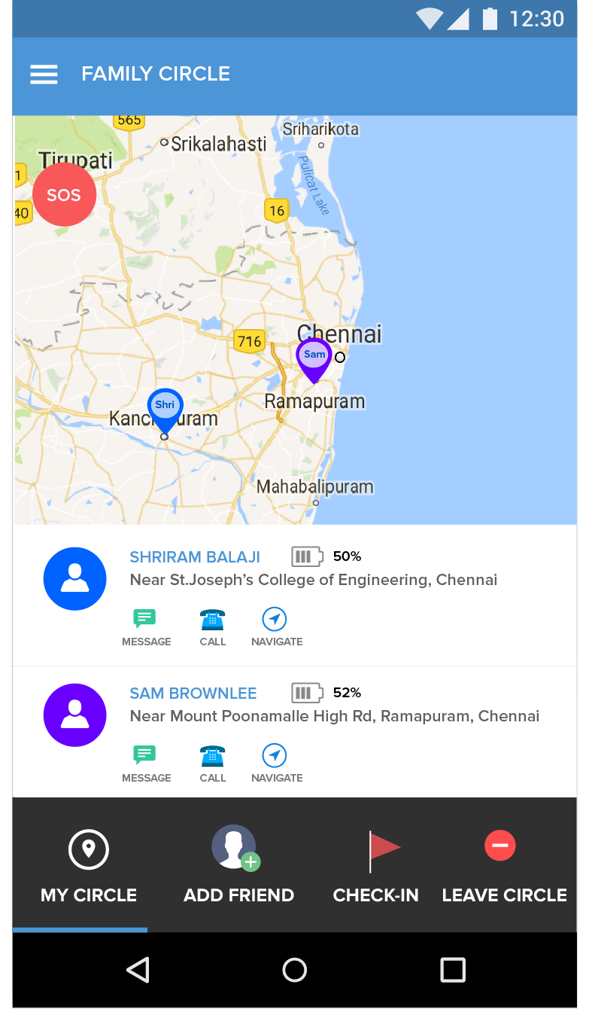
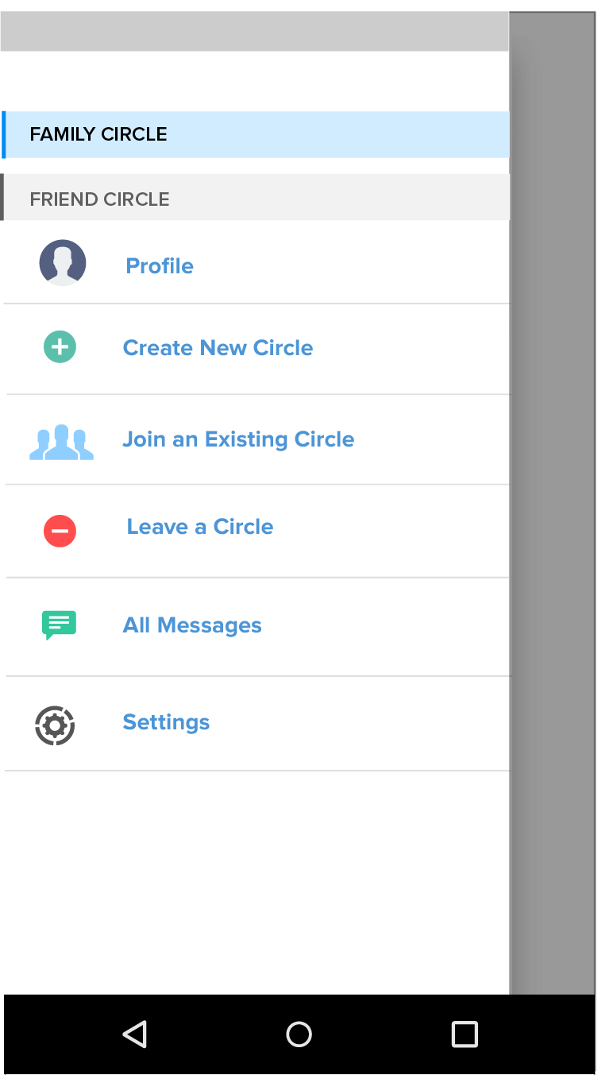
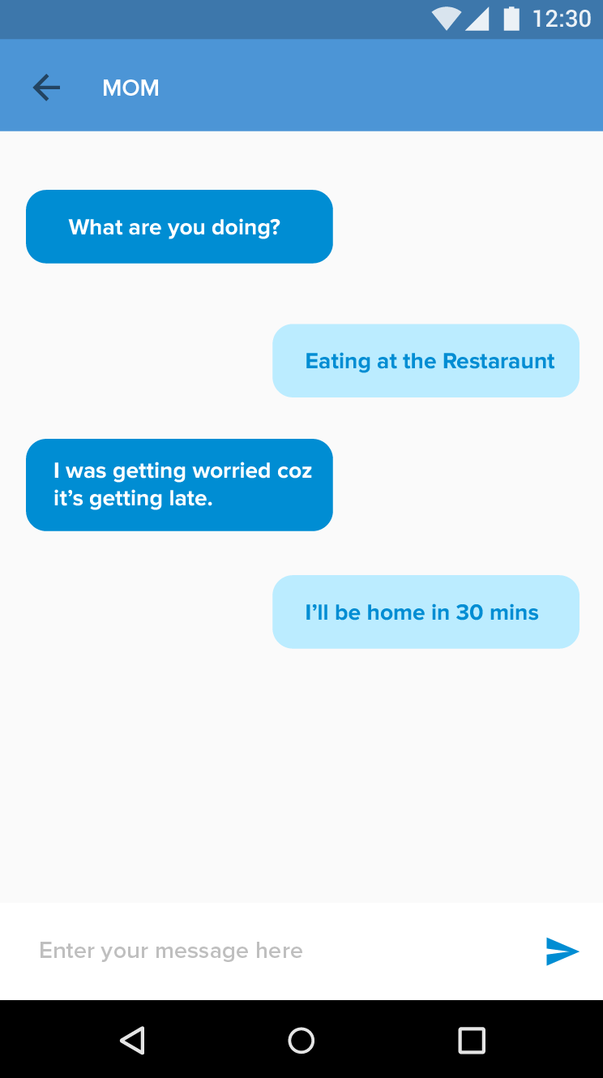
User Interface Prototypes

Slide 4
Technology Stack
Android SDK
Backend : Google Firebase Platform
Repository and Versioning Tools : Github

Slide 5
Android Application Platform
The Software Development Kit in Android contain bundles of data including Tools, Libraries &Emulator.
The basic Android-System is a Linux system.
Android uses a custom Linux kernel with some extra functionality on power-saving and some speed-improvements.
The internal storage of an Android device is formatted with the ’YAFFS2-filesystem’, which fully features the Linux-like access-concepts.
Android SDK runs predominantly on Java and hence uses object oriented code style by default.

Slide 6
Firebase Platform
As a real-time, scalable backend platform, Firebase provide the tools that are needed to quickly build rich, collaborative applications that can serve millions of users.
With 100% Firebase-powered apps, user authentication can be handled by a Simple Login service which supports Facebook, Twitter, Github and Google; in addition to a regular email/password login scheme.
Firebase is great at propagating data in real-time across all the clients.
The Firebase database is accessible directly from any client, be it a mobile device or web browser.

Slide 7
Dependencies
Google Maps API
Maps API is used in order to precisely identify the current location of the user and providing frequent updates to the family circle.
Digits API
Digits is a platform used for mobile authentication using OTP and enables a
hassle free login.

Slide 8
Google Maps API
Google Maps will be used to visualize maps and connect the app to millions of places with native API for Android.
Maps are represented in the API by the GoogleMap and MapFragment classes.
Cross-platform custom styling enables you to change the color palette of your maps, hide labels, vary road density and toggle points of interest.
The data can be got from the same database used by Google Maps and Google+ Local.
Places features over 100 million businesses and points of interest that are updated frequently through owner-verified listings and user-moderated contributions.

Slide 9
Digits by Fabric – OTP Generation
Digits helps onboard your mobile app users with simple phone number authentication so you can build safe, viral communities.
Digits sends users an SMS confirmation code, which they enter into your app to confirm their identity - you can authenticate users in two steps! If the code doesn't arrive quickly, built-in voice fall-back comes to the rescue. See how it works by typing in your phone number.
It has meticulously optimized the performance, scalability, and availability of our infrastructure by building strong relationships with SMS carriers and adding dynamic SMS routing. We have taken extreme care to ensure your app data is safe and protected.

Slide 10
Showstoppers
Location services consume increased power and are not optimized for efficient usage.
Network Connectivity is required for functioning of the application.
Privacy concerns may raise at certain situation.

Slide 11
Use Cases:
Police Officers during Field Operations
The group of members in an elite force who are infiltrating a terrorist location can use this mobile based application that will help people to locate other members of group in real time using GPS technology.
Safety and Emergency Alerts among Family Members
The location of family members can be kept in track. In case of emergency, “SOS” button can be pressed. It will send the alert messages to the trusted contacts and the nearest police station will be displayed on the map.
Hostage Rescue Operations
In a military rescue operation, the location of the team members and the target can be monitored to keep them on track and their details will be transmitted to military base station.
Parental Monitoring
Children can be monitored by tracking their location they are currently at, the path they have travelled and their safety can be ensured.

